Slide 1
CS 387 623
Group Project
Team 4
Chen Zheming https://github.com/qqwwsyz
Tang Guo https://github.com/gtang1104

Slide 2
Content
1. Schema to ERD
2. Java Program
3. Transaction Execution

Slide 3
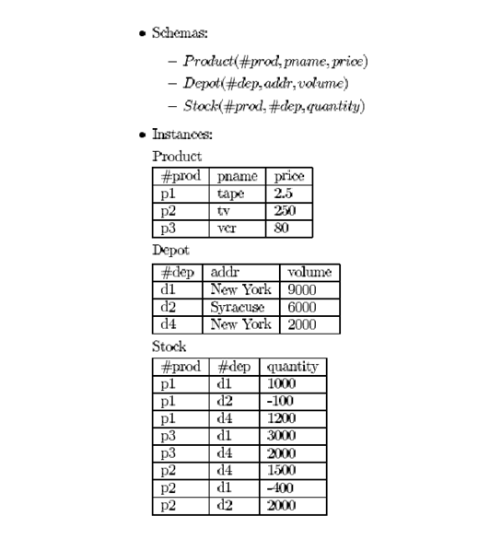
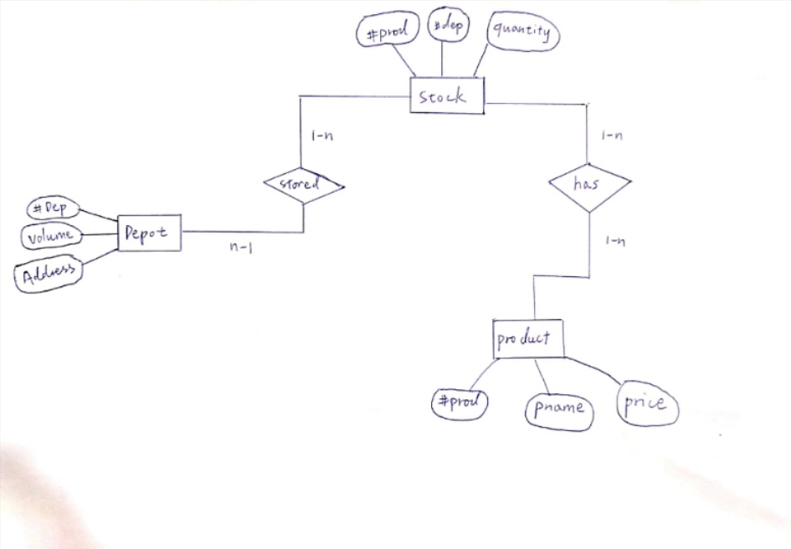
Schema to ERD

Slide 4
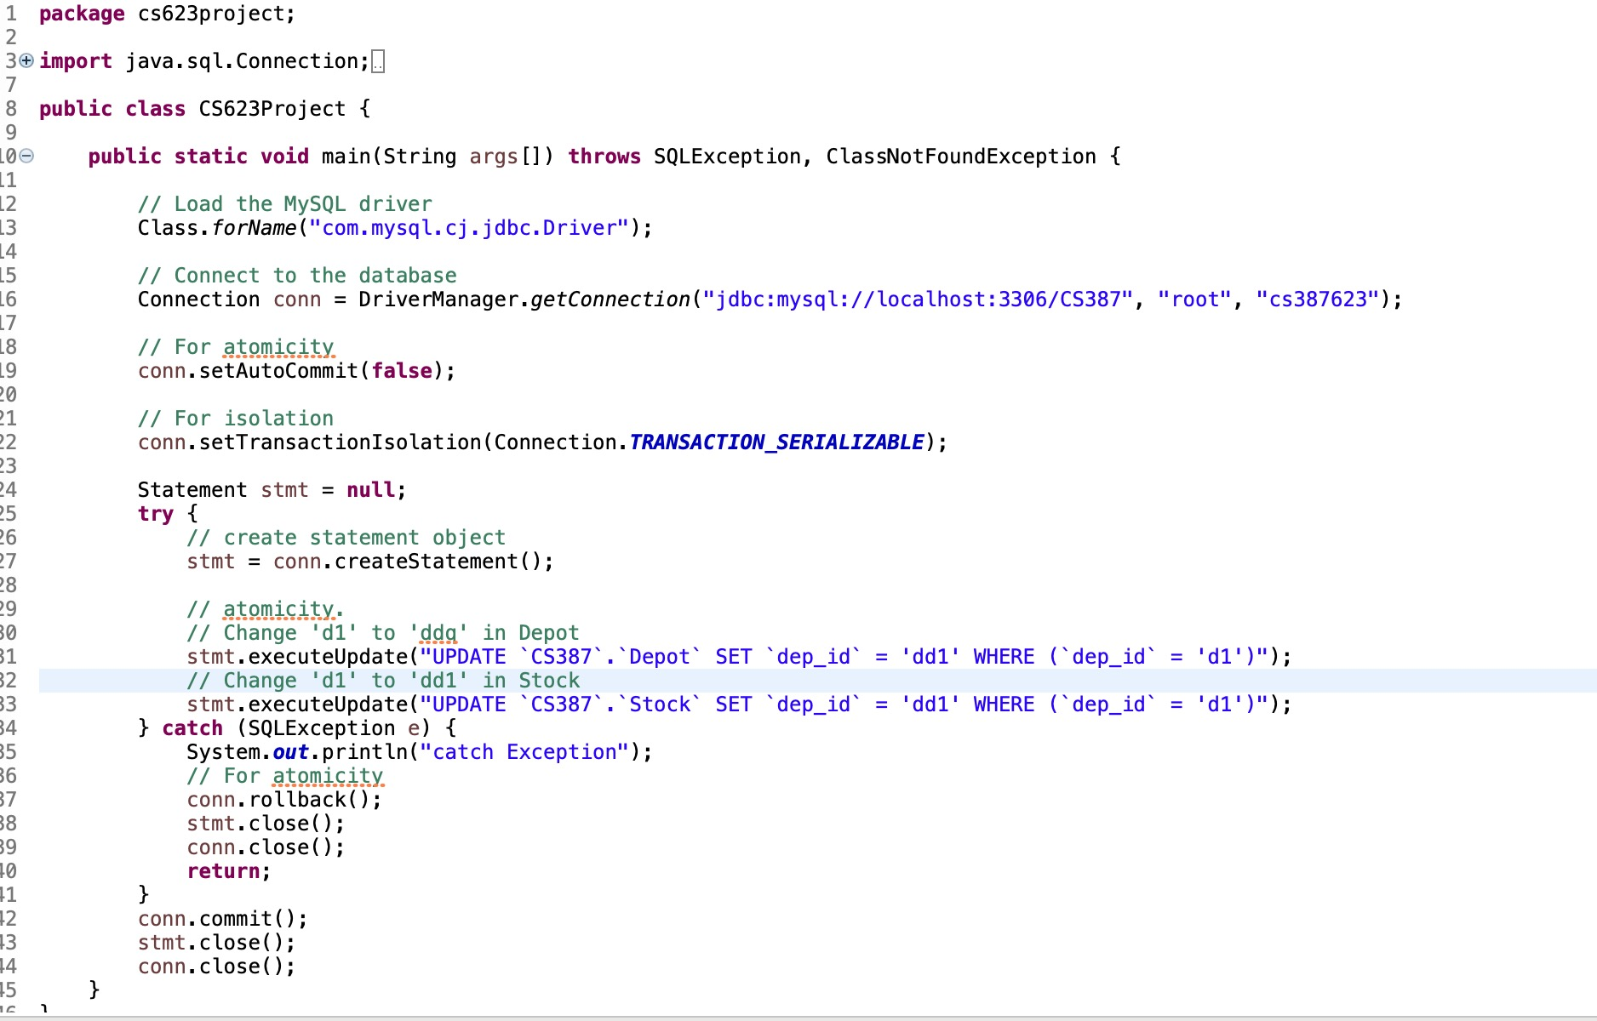
Java Program

Slide 5
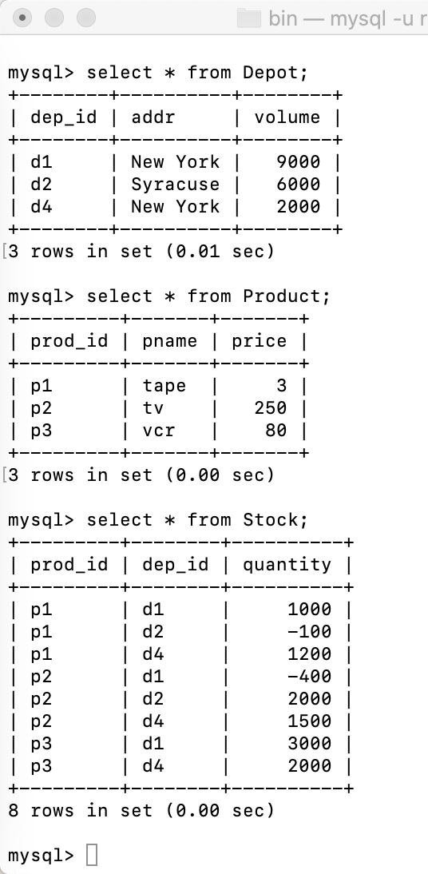
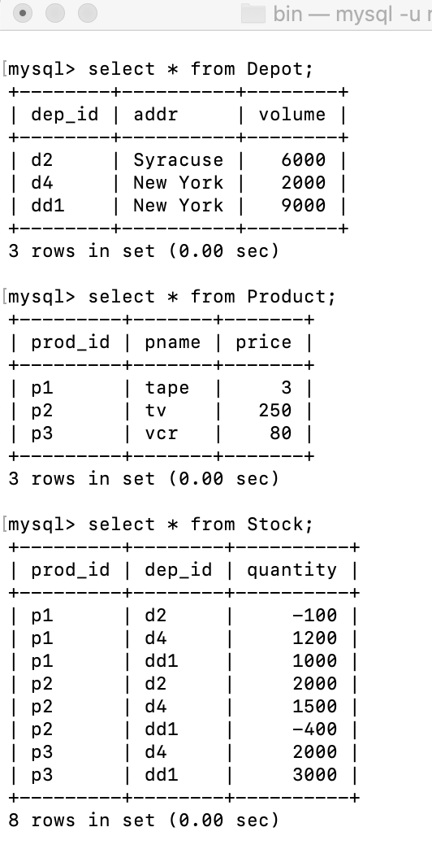
Transaction Execution

Slide 6
Thank you

